Slide 1
Smart Course Recommender System
Shuja Ur Rehman (2016-Isc-60)
Syed Asad Ali Bukhari (2016-Isc-69)
Final Year Project

Slide 2
introduction
Smart course recommender is to help university students and professional individuals to find subjects of their interest and also provide online sources from where they can easily study a particular course. As students rush to schedule classes for the next semester, they feel overwhelmed by the number of options the institute has to offer. Moreover, if a student wants to take up a certain course and there is no room for them, there is little time to change their opinion. If the courses are recommended to students, they would have a potential list of top courses that will appeal to their interests and majors so they are not left in a doubt.

Slide 3
Project overview
Our main goal is to provide undergraduate students a platform where they can easily get help in finding different subjects in which they are interested. Moreover, this project also recommends limited number of courses to students to study per semester based on level of difficulty of the courses. According to research done by group members, website provides their students this type of recommender system to help them figure out what they should study and how many courses to study in a semester and the difficulty level of the subject.

Slide 4
Project Objective
This system allows students to plan their courses for an individual term, multiple terms, or for their entire duration at the university. This would allow students to track their progress towards meeting the requirements associated with their career objectives, manage personalized academic plans where requirements are directly linked to course Sign up, and eliminate the need to access separate systems to track a student’s history, grades, academic plans and other information.

Slide 5
enhancement
As of right now, we have only selected computer science field for the students to take recommendation from, but in the future, we can expand this area as there are a lot of fields in the world, such as medicine, business, architecture and so on. We can accumulate courses related to these fields and many more students (belonging to these fields) can use the recommendation service. Moreover, we can introduce feedback of the system and of the courses listed in the website.

Slide 6
List of actors
1. Administrator
2. Students

Slide 7
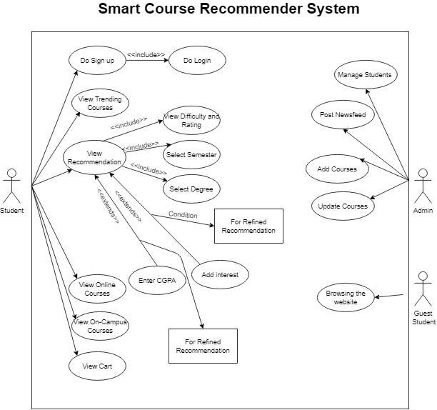
System Use Case Diagrams

Slide 8
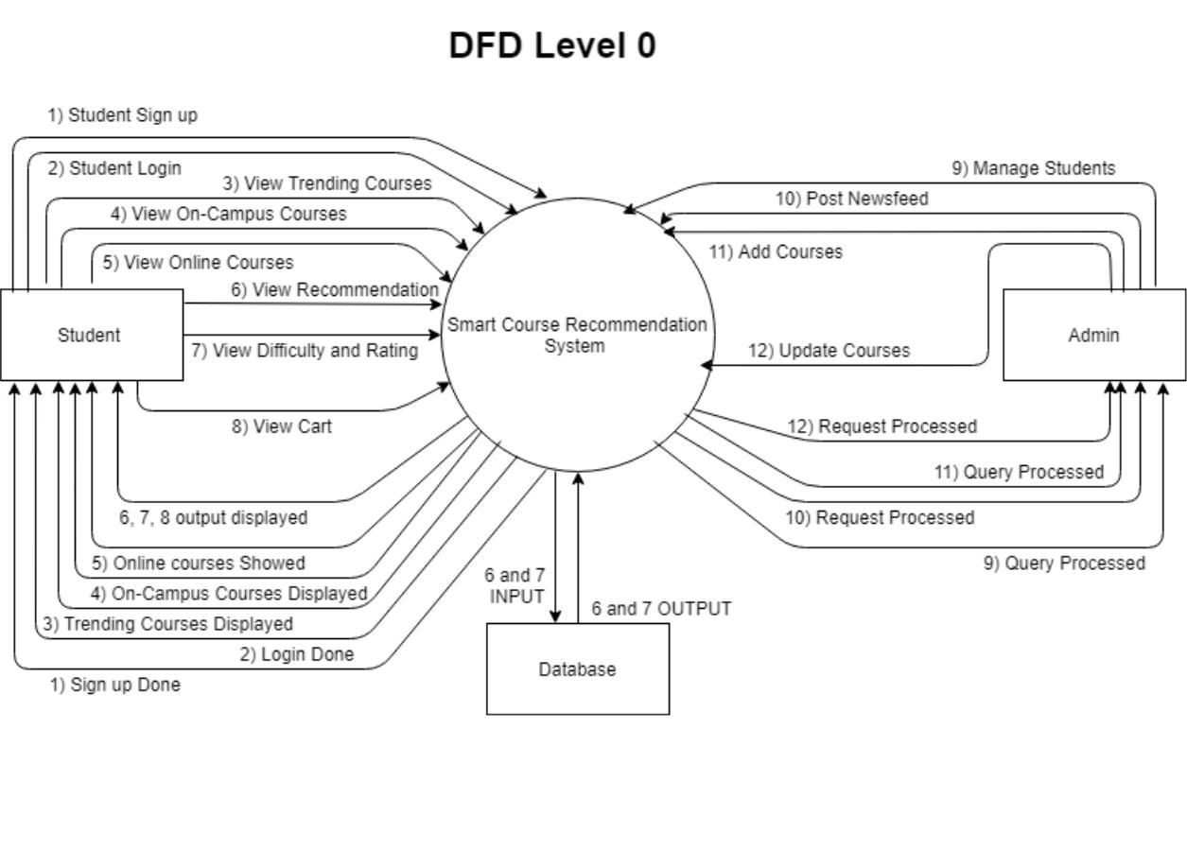
DATA flow diagrams (level-0)

Slide 9
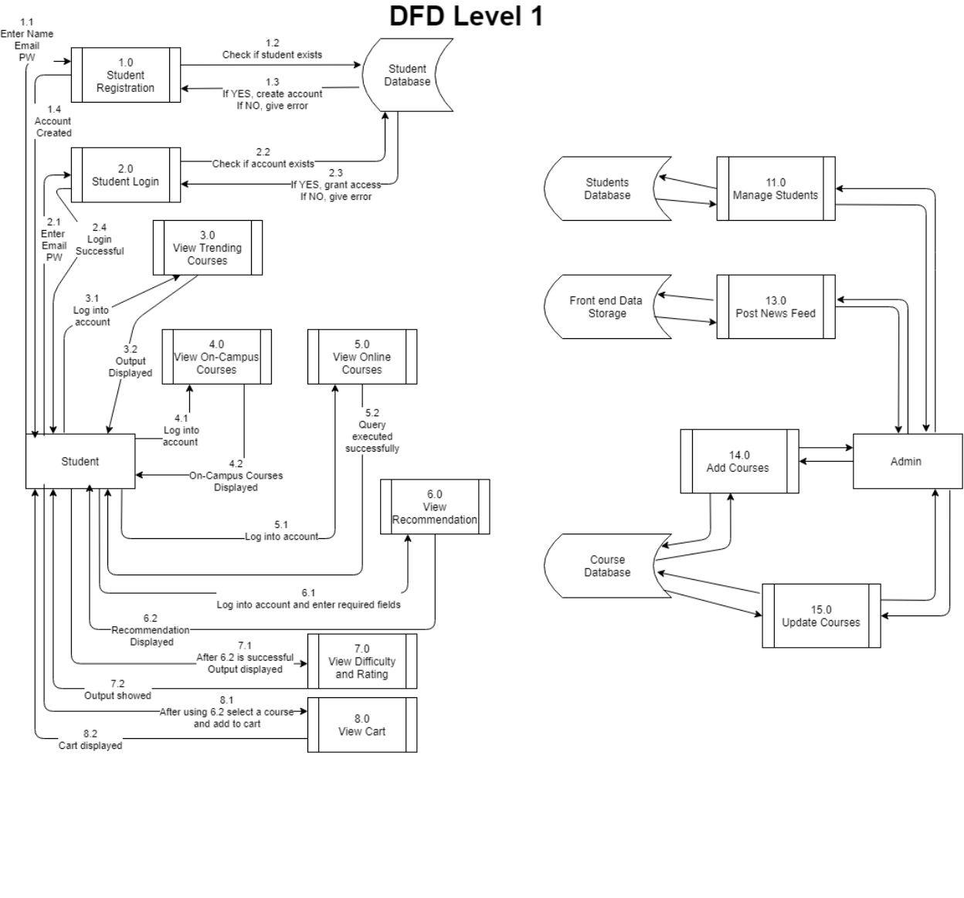
DATA flow diagrams (level-1)

Slide 10
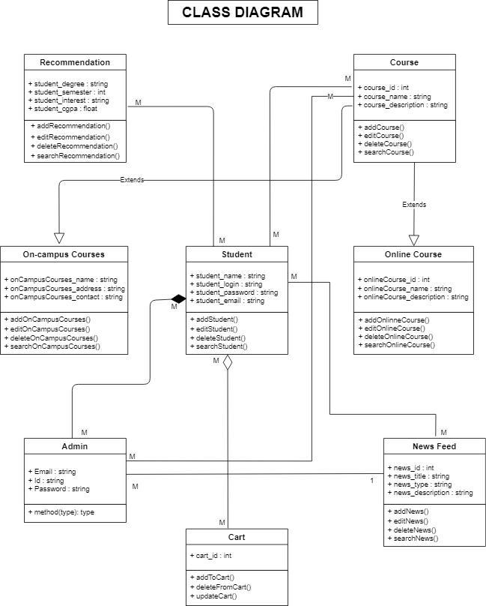
Class Diagram

Slide 11
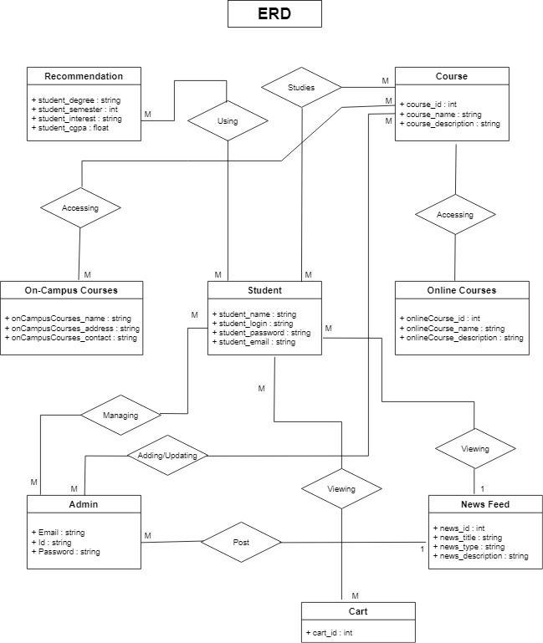
Entity relationship diagram (er-d)

Slide 12
Development Setup
Django (Python framework for developing website’s backend)
ReactJS (JavaScript framework for developing website’s frontend)

Slide 13
conclusion
We have successfully created a Smart Course Recommender System whose purpose is to make recommendations related to the courses that student want to study. Moreover, it provides a choice to choose from online and on-campus courses for different computer science related courses to study from and the on-campus courses that are being taught at PUCIT. We have implemented this project using Django and ReactJS frameworks that have immense significance in the technology industry. We are also using Rest API to transfer data from frontend to backend and vice versa. We collected our own dataset from two main sources that have a huge collection of courses in almost every field.

Slide 14
THANK YOU

